Slide 1
“Tantangan Dan Peluang UMKM Aceh Di Era Baru”
DR. Iskandarsyah Madjid

Slide 2
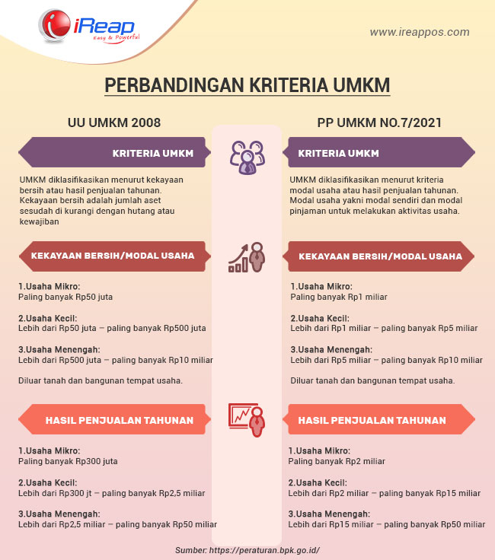

Slide 3
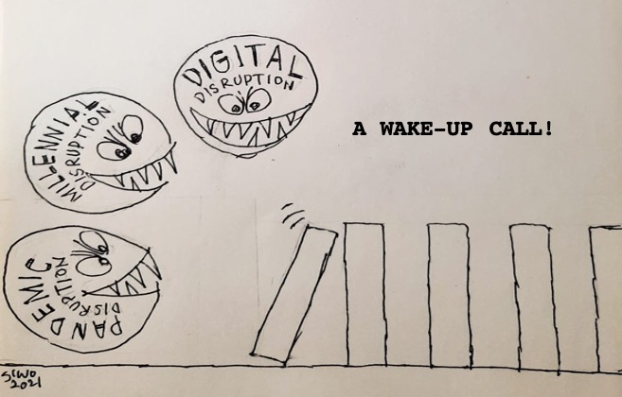
Triple Disruption

Slide 9
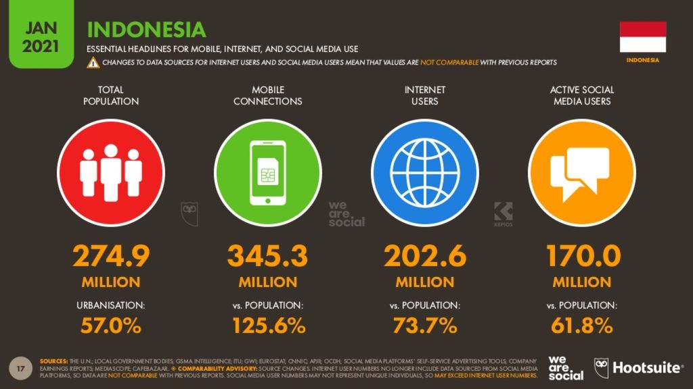

Slide 10
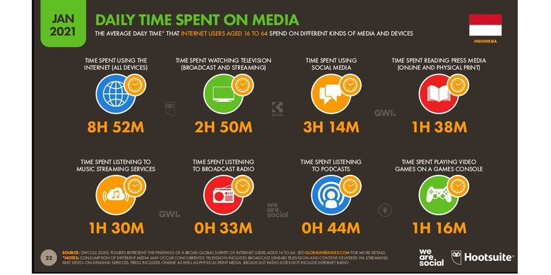

Slide 11
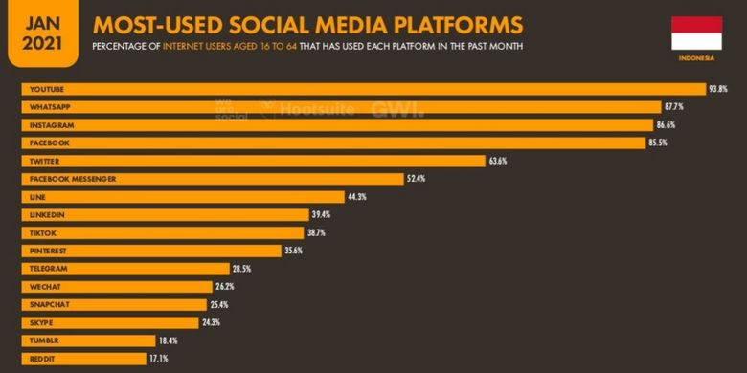

Slide 14
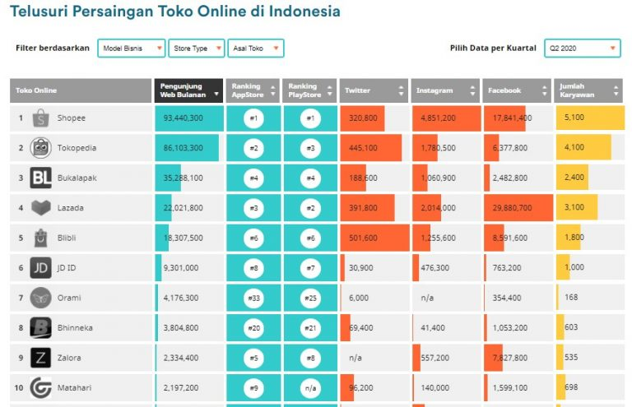

Slide 16
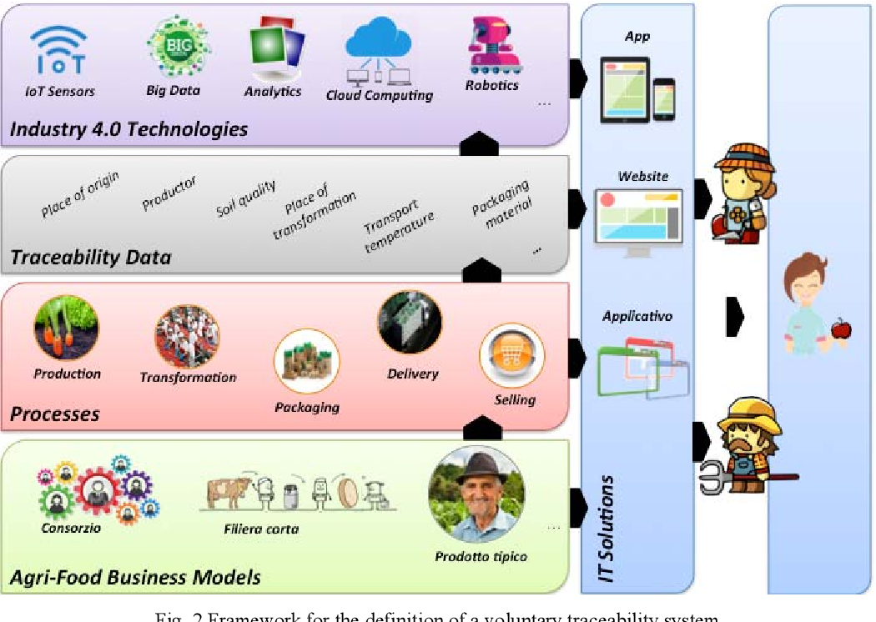

Slide 17
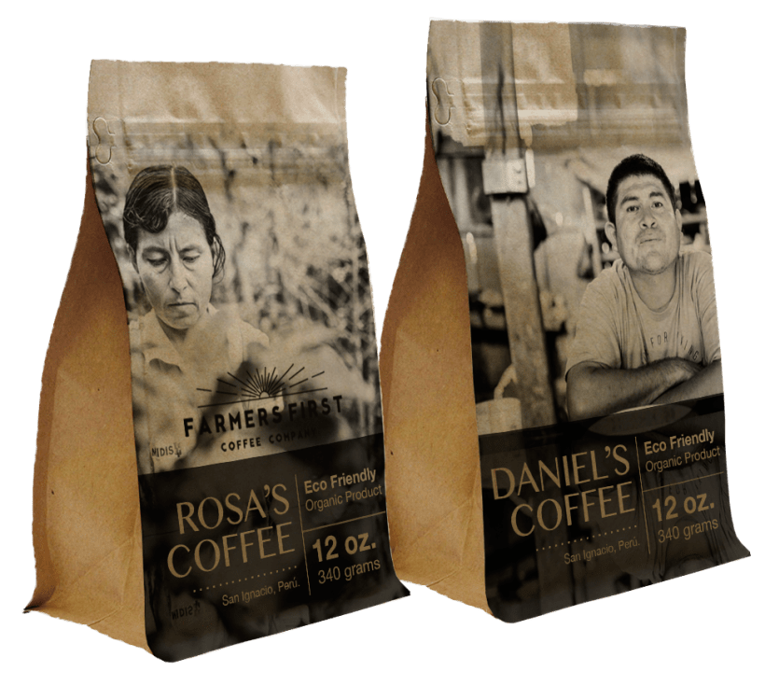

Slide 18
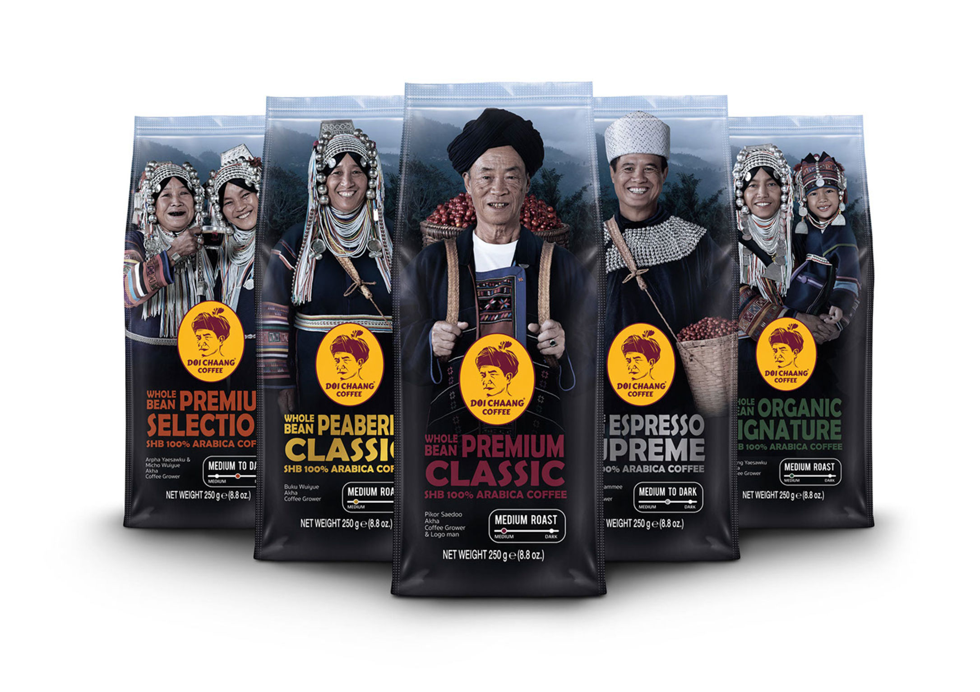
In each production and processing of Doi Chaang coffee starting from planting Hand picking fresh coffee from the plant Wet processing is selected until the most suitable process to create the flavor until Doi Chaang coffee is a specialty Arabica coffee (Specialty coffee) grown only in Doi Chang area. It has been certified by many international standards with a unique scent that is particularly fragrant. sour (fruit acids) that drink and make your throat feel low in caffeine It has a high mellow flavor. It is the perfect balance between arable land and highland terrain with cold weather all year round. together with care and attention in every step resulting in high quality Arabica coffee As the saying goes, “Doi Chaang Coffee, the identity of Thai coffee. The best coffee in the world”

Slide 20
TERIMA KASIH 08116807444

